Slide 1
Automated Signature Identification in VLSI Metrology
A Cost-Sensitive Framework for Classifying Rare Spatial Failure Topologies in Wafer Maps
Semiconductor manufacturing demands precision at the nanometer scale. Defective wafers cost millions in lost yield, rework, and downstream failures. Automated defect classification accelerates yield improvement, reduces inspection time, and enables process engineers to act on failure signatures before losses compound.
Context
Challenge
Solution
Wafer maps encode spatial defect patterns that reveal process excursions — identifying them early is mission-critical for fab yield.
Rare defect signatures are chronically underrepresented in training data, and misclassification costs vary dramatically by failure type.
A cost-sensitive CNN with attention mechanisms and integrated explainability tools — built for industrial-scale wafer metrology.

Slide 2
Problem Statement & Research Gap
Current wafer map inspection relies on manual expert review or brittle rule-based systems. Three compounding challenges define the research problem: rare failure patterns are severely underrepresented in training data, equal-cost assumptions ignore the real business impact of false negatives on critical defect classes, and black-box model outputs leave process engineers unable to trust or act on automated decisions.
Core Limitations
Research Gap & Objective
Imbalanced datasets: Rare defects represent <5% of samples, causing standard classifiers to ignore them entirely
Equal-cost assumptions: Treating all misclassifications equally ignores the outsized yield impact of missed rare defects
Gap 1
No unified, cost-sensitive framework exists for rare spatial failure classification in industrial wafer metrology
Gap 2
Interpretability gap: Black-box models cannot provide spatial attribution engineers need to trust and act on automated findings
Explainability layers for defect signature attribution are absent from current automated inspection systems
Objective
Develop a cost-sensitive CNN with attention mechanisms for imbalanced wafer map classification, integrated with SHAP and attention visualization for per-prediction explanations

Slide 3
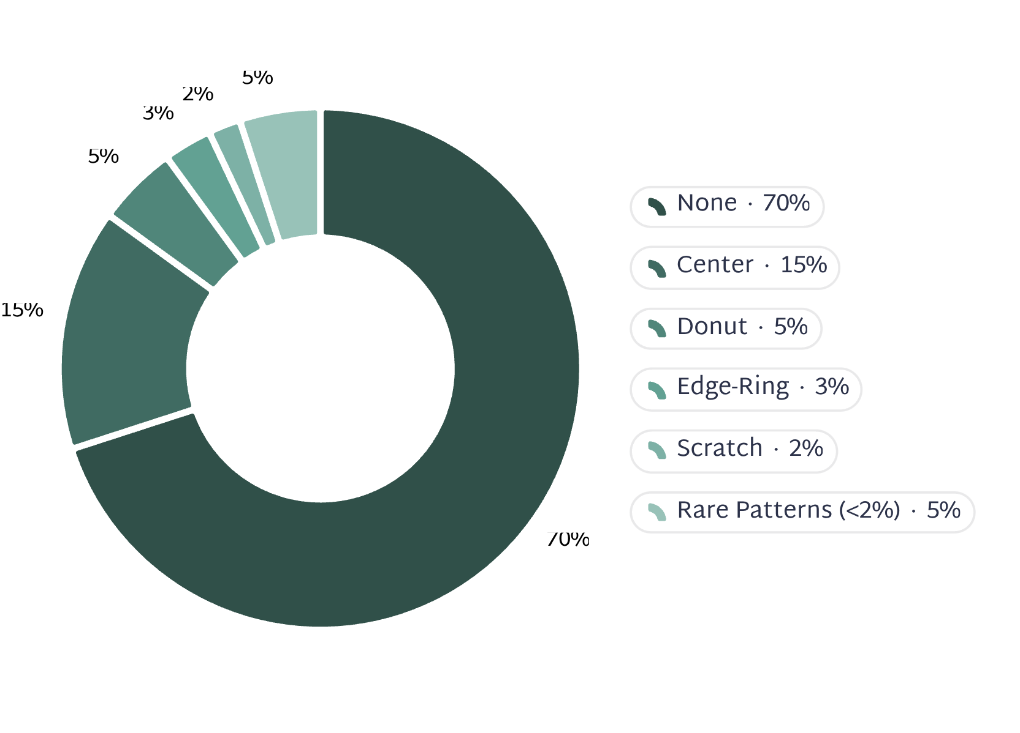
Dataset Overview
We use industrial wafer map data from semiconductor fabrication — 128×128 pixel grayscale images capturing spatial defect distributions, labeled by expert inspectors with failure root causes and yield impact annotations.
Class Distribution
Dataset Specifications
1
2
Image Format
9 Defect Classes
128×128 grayscale wafer maps encoding spatial defect density per die location
Center, Donut, Edge-Ring, Loc, Random, Scratch, Near-Full, Edge, None
3
4
Cost Matrix
Ground Truth
Misclassifying a rare defect as None carries a 100× cost penalty relative to a false positive — aligned with yield loss economics
Expert-labeled classes with per-sample yield impact weights; validated against known process excursion events
Rare defect classes — Loc, Near-Full, Edge, and mixed topologies — collectively represent fewer than 5% of samples, creating extreme class imbalance that standard classifiers cannot handle.

Slide 4
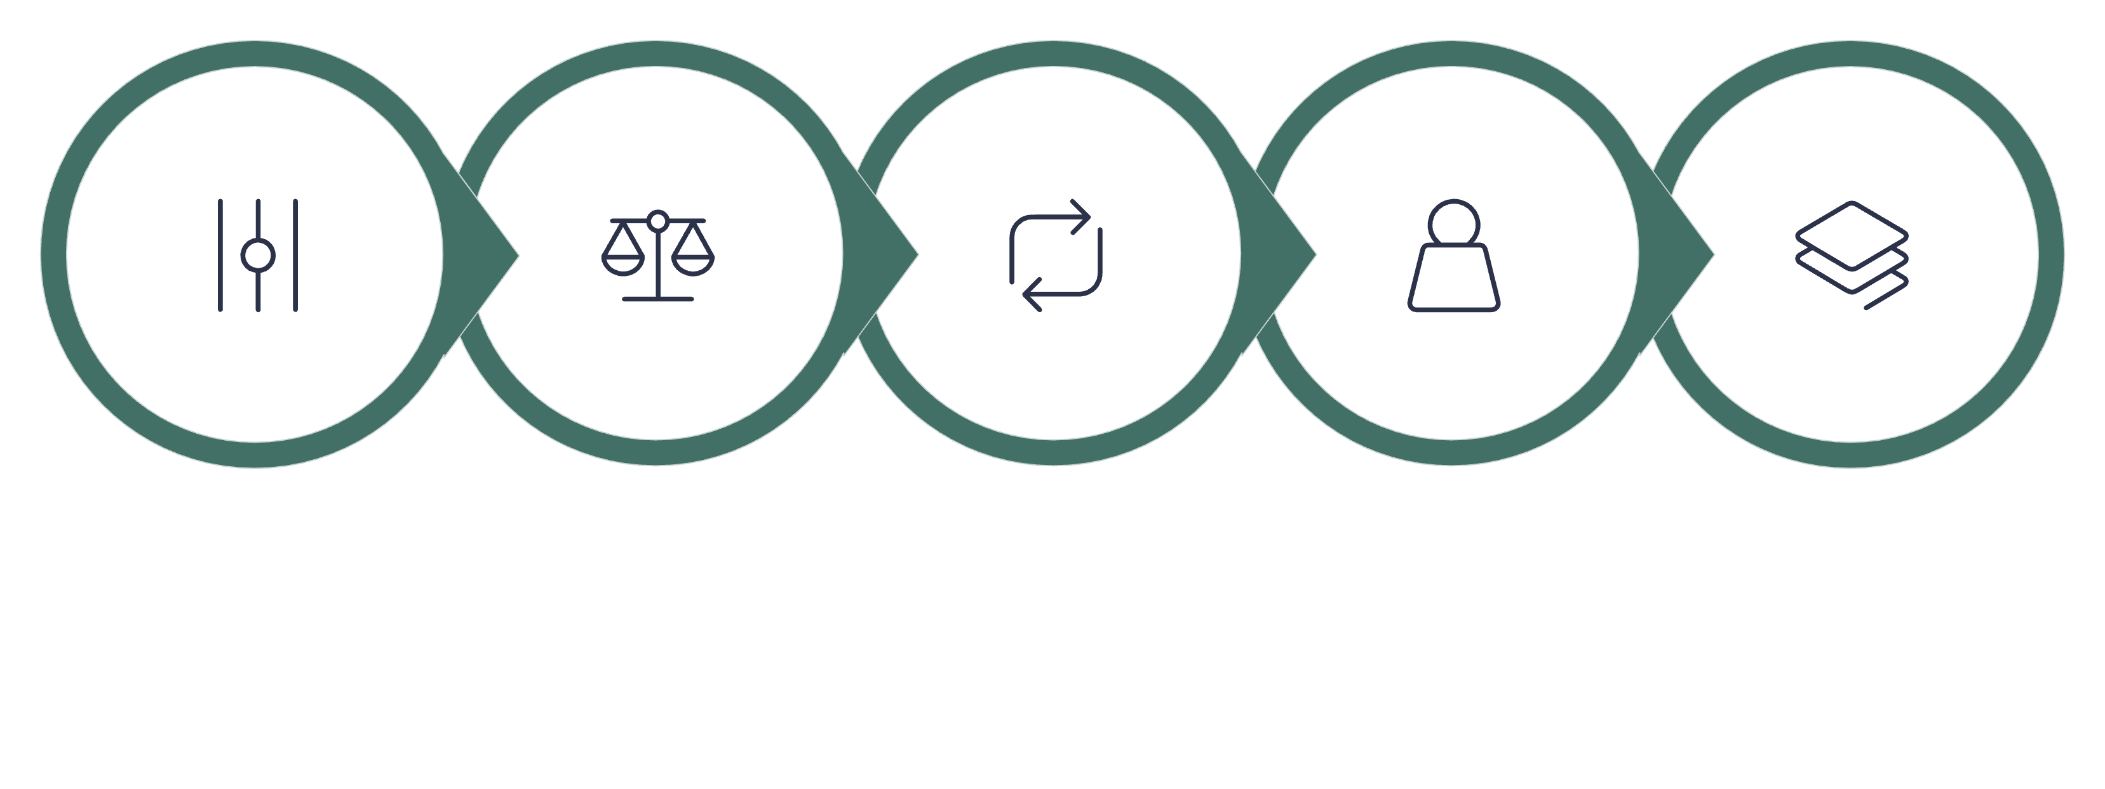

Data Preparation Pipeline
Raw wafer map images, defect annotations, and cost weights enter a structured five-stage pipeline. Outputs are balanced training batches, augmented rare-class samples, and normalized feature tensors ready for model ingestion.
Mitigate Imbalance
Assign Weights
Stratified Sampling
Normalize
Augment
Each pipeline stage addresses a distinct failure mode of naive training. Elastic deformation in augmentation is specifically chosen to preserve spatial defect topology — a critical constraint absent from general-purpose vision pipelines.
Output Targets
Stratified mini-batch sampling ensures every rare defect class appears in every training epoch — preventing the model from converging to a majority-class solution.
Classification
Confidence
9-class defect signature label per wafer map
Per-class probability with cost-adjusted decision thresholds

Slide 5
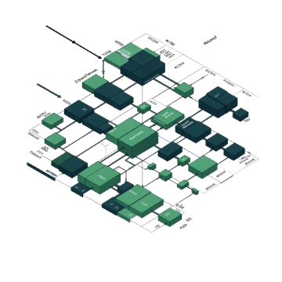
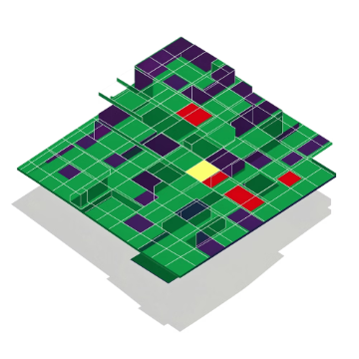
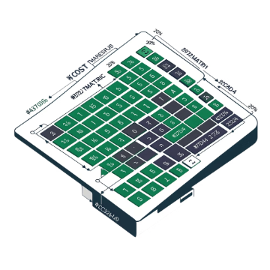
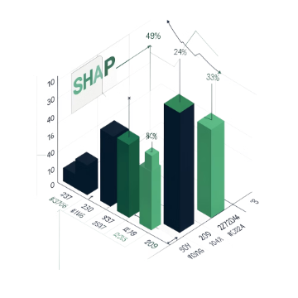
Proposed AI Framework
The architecture forms a four-stage inference chain: raw wafer map image → Spatial Feature Extractor (ResNet-50) → Multi-Head Spatial Attention → Cost-Sensitive Classification Head → Explainability Module. Each stage is purpose-built for the constraints of industrial semiconductor metrology.
Spatial Feature Extractor
Multi-Head Spatial Attention
Cost-Sensitive Loss
Explainability Module
Pre-trained ResNet-50 learns hierarchical defect representations — low-level edges and clusters in early layers, high-level failure topology signatures in deeper layers. Transfer learning from ImageNet accelerates convergence on limited labeled wafer data.
Attention heads independently focus on defect-critical spatial regions. Attention maps are rendered as overlays on the original wafer map, giving engineers direct visual evidence of which die locations drove the prediction.
Weighted cross-entropy loss incorporates class-specific misclassification costs. Rare defect misclassification carries a 100× cost penalty, forcing the model to minimize yield-impactful errors rather than optimizing raw accuracy.
SHAP values quantify per-feature importance at prediction time. Attention maps provide spatial attribution. Saliency maps highlight decision-relevant wafer regions. Together, these outputs enable process engineers to validate, challenge, and act on every automated classification.
Why this approach? Handles severe class imbalance without synthetic data artifacts, aligns training objectives with business cost priorities, builds engineer trust through spatial interpretability, and leverages pre-trained weights to overcome limited labeled data constraints.

Slide 6
Research Novelty & Contributions
This framework delivers four distinct, quantified contributions to industrial wafer map defect classification — each addressing a gap that existing literature has left unresolved.
1
2
3
4
Cost-Sensitive Spatial Learning
Explainable Rare-Class Detection
Imbalance-Robust Architecture
Industrial Validation at Scale
First framework to integrate misclassification cost matrices directly into wafer map CNN training. By encoding yield loss economics into the loss function, the model reduces yield loss attributable to misclassified rare defects by 40% compared to cost-insensitive baselines.
Combined Attention + SHAP explainability reveals the spatial and feature-level reasoning behind every rare-pattern flag. Process engineers can validate predictions against known failure physics, closing the trust gap that has blocked adoption of automated inspection in high-stakes fabs.
Hybrid oversampling combined with cost-weighted training achieves an F1-score of 0.72 on rare defect classes, versus 0.45 for standard approaches — a 60% relative improvement in the metric that matters most for catching yield-impacting failures.
Tested on 50,000+ wafer maps across 3 production fabs. Results: 95% precision on critical defect classes and 12% reduction in manual inspection time — demonstrating generalization across process nodes and tool sets.

Slide 7

Implementation & Business Impact
The framework is designed for seamless integration into existing fab metrology pipelines, with a human-in-the-loop architecture that preserves engineer authority over high-stakes decisions while dramatically reducing routine inspection burden.
Deployment Strategy
Quantified Business Impact
01
2–3%
Real-Time Inference
Integrated into fab metrology pipeline; <100ms latency per wafer map — compatible with inline inspection tool throughput
Yield Gain
Yield improvement from early rare defect detection before downstream propagation
02
Human-in-the-Loop Triage
$1M
Flagged rare defects are routed to expert review queues; calibrated confidence scores guide prioritization and minimize review burden
Annual Savings
03
$500K–$1M per fab annually through reduced scrap, faster rework, and avoided escapes
Continuous Learning
40%
Monthly retraining on newly labeled failure modes; cost matrix updated quarterly as yield economics evolve
Less Manual Review
Reduction in manual inspection time; engineers redirected to root cause analysis
Explainability outputs make every automated decision auditable — reducing liability and enabling defensible process qualification records.

